Slide 1
Learning about Learning
Planning your strategies for performance in European Handball

Slide 2
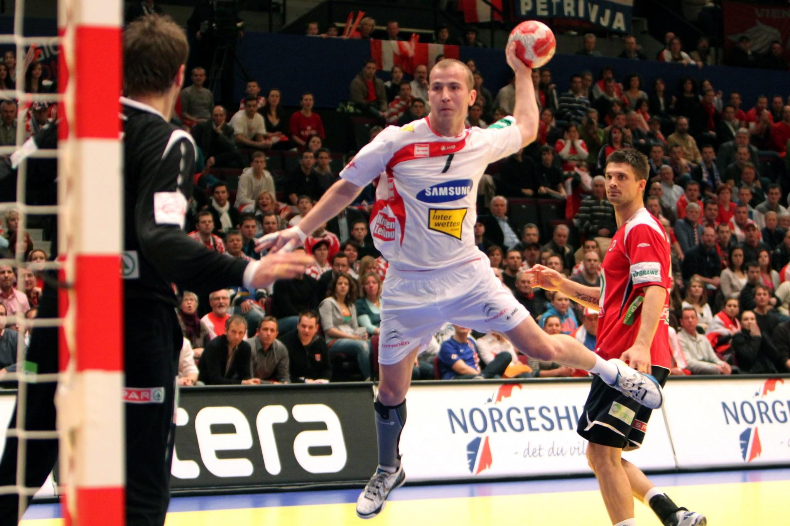
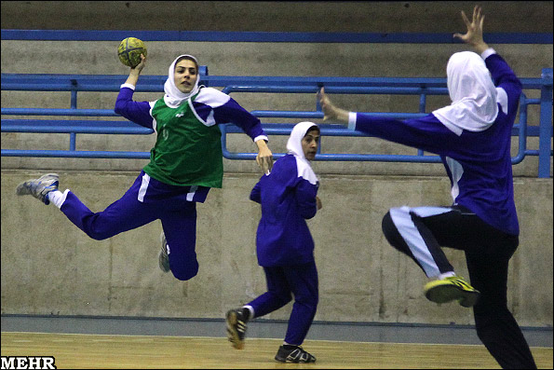
Strategies will be developed from two areas:
Knowledge of Technique
Quality of Practice

Slide 3
Skills...could include
Passing
Passing on the run
Shooting
Dribbling
Moving with the ball

Slide 4
Strategies for Improving Technique/s
(knowledge of technique)
Variable Practice - this is particularly important for learners in the Control and Skillful stages of Newells model
Experimentation - learners need opportunity to take risk and experiment, to see what the potential solutions are, particularly in the co-ordination stage of Newells model
Learning through observation - this may help you to see the possibilities of technique solutions beyond what you have considered yourself
Representative Design - Creating an environment that best reflects the game in which you will be playing. Designing practices to help individuals read a range of environment and task cues (constraints)
Notes:
You will have identified your strengths and weaknesses and self evaluated against the Handball rubric. You may like to consider this when choosing a skill within handball that you would like to improve. The idea is that you then select a strategy to apply in practice sessions in order to improve in this skill.
The strategy must be one that allows you to consider ‘ knowledge of technique’ or ‘experience of a range of possible techniques’ in order to improve your performance of this skill area. This part of the skill acquisition programme will be student led and could be done in groups with students who are working on similar skills
Some suggestions have been outlined in the slide above.

Slide 5
Strategies to enhance the Quality of Practice
(Quality of Practice)
Use of task constraints - how can we modify rules, equipment, spaces used to encourage learning
Development of indiv constraints - you may have aspects of your individual constraints that can be developed further through quality practice and will help your learning eg. motivation, fitness, strength
Notes:
The strategy used for quality of practice will enable to develop as a ‘whole’player. It does not need to focus on just ‘skill’. These strategies will be implemented by your teacher and you will choose to reflect on how they influenced learning / performance.

