Slide 1



Why Solvay for your exchange?

Slide 2
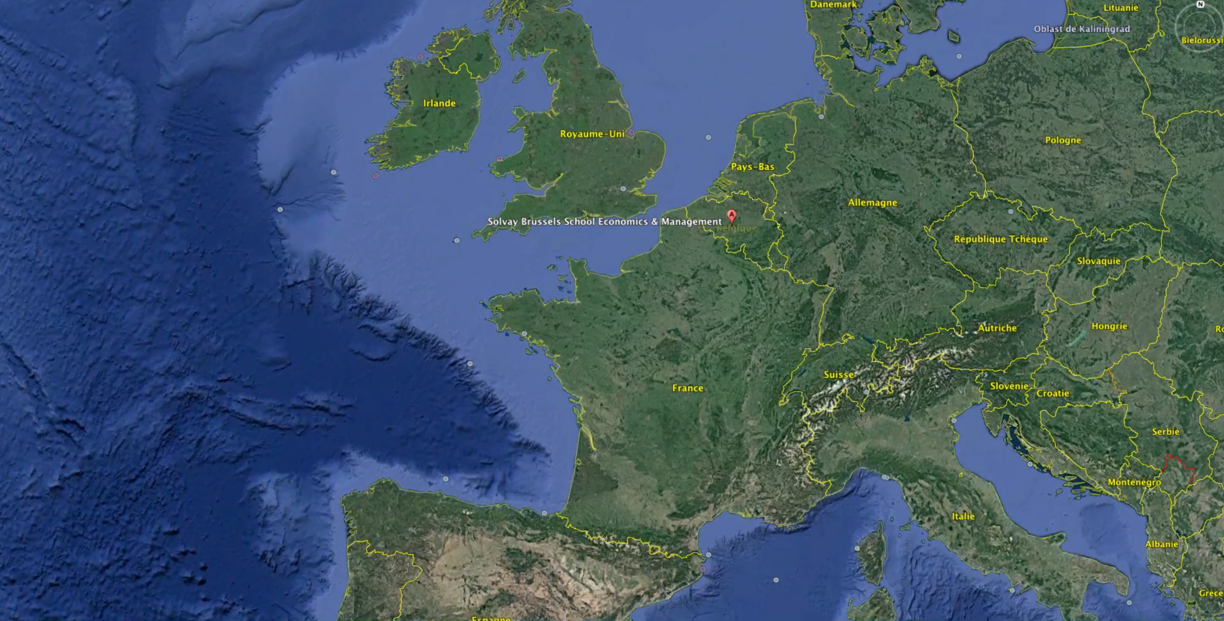
Central location in Europe
source: google earth

Slide 3
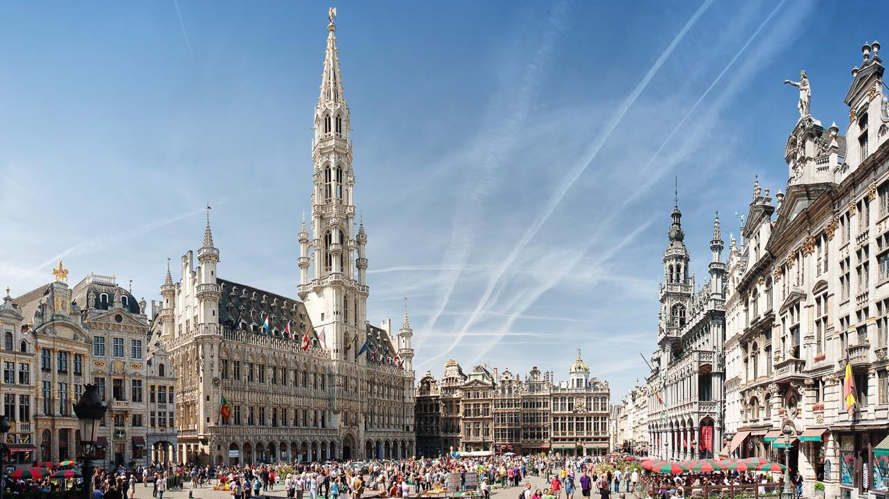
A capital city
in the heart of Europe
1:20 hour from Paris
2:10 hours from London
1:50 hours from Amsterdam & Cologne

Slide 4

Cosmopolitan & Multicultural
Notes:
facts & figures
62% were born outside of Belgium
Source: http://focusonbelgium.be/en/international/brussels-2nd-most-cosmopolitan-city

Slide 5
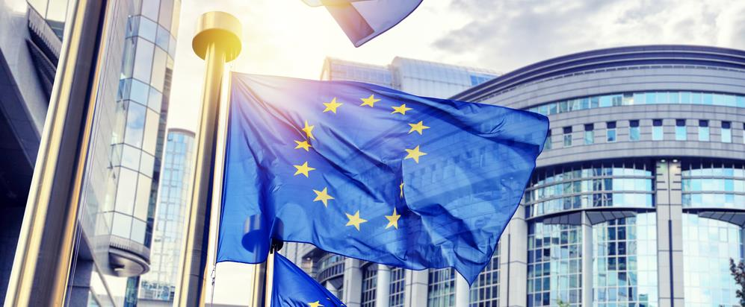
The European Institutions & NATO

Slide 6





International corporations

Slide 7
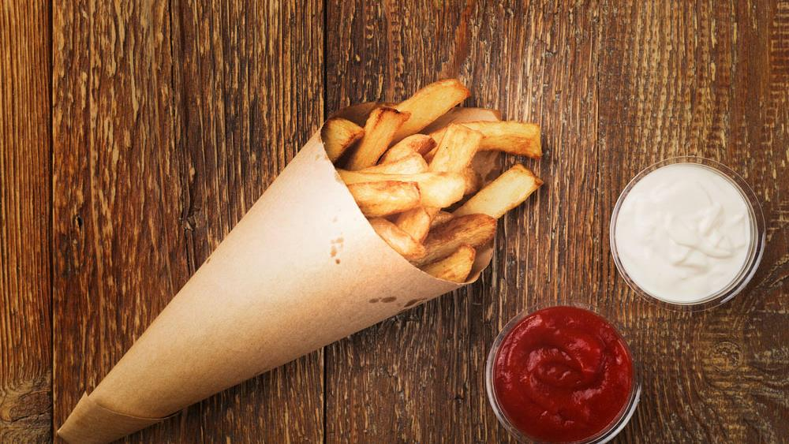
Belgian culture

Slide 8
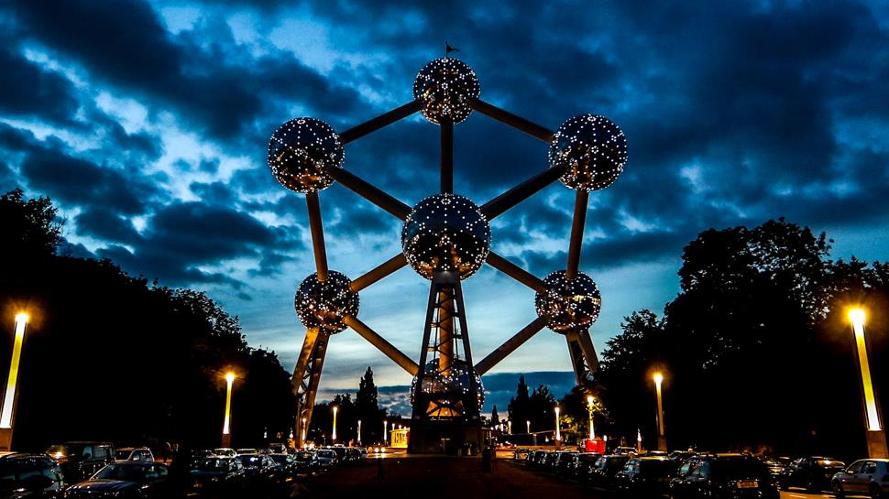
Iconic places

Slide 9
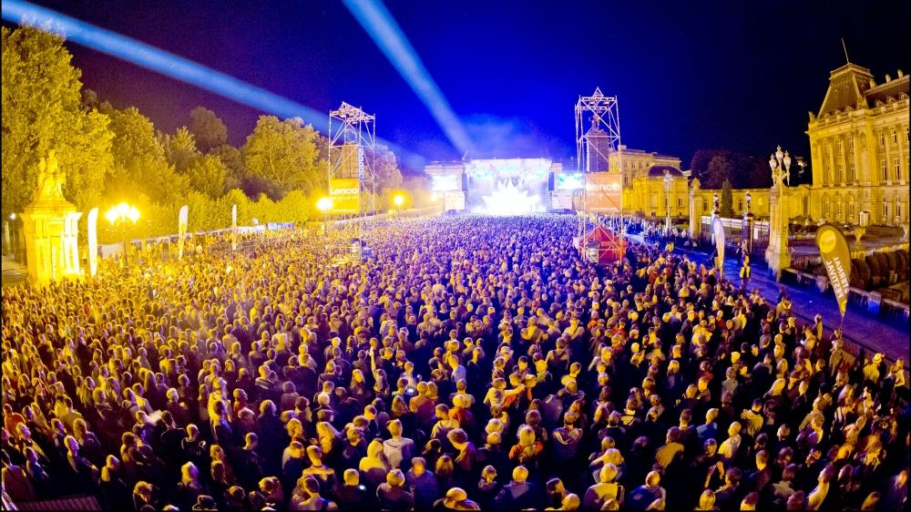
Fiesta & festivals!!!

Slide 10
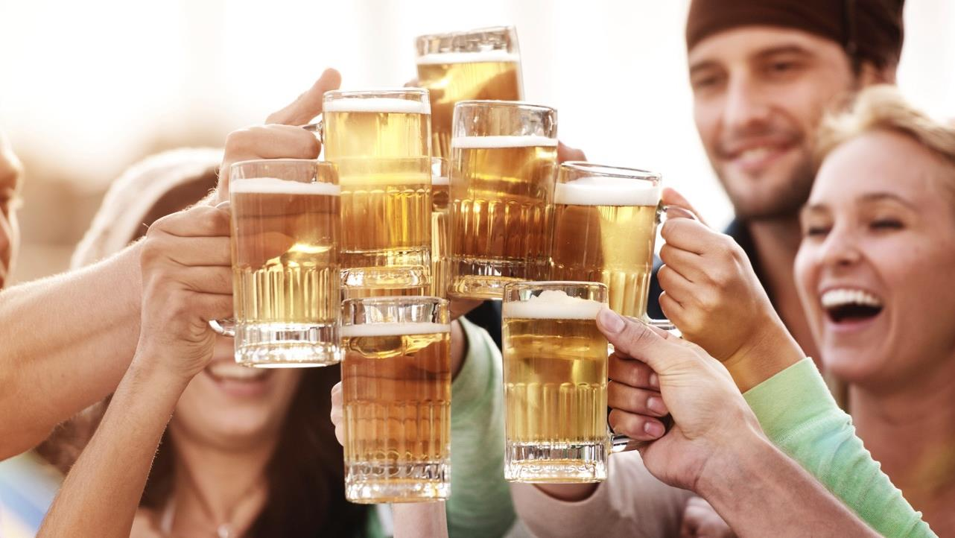
Among others!

Slide 11
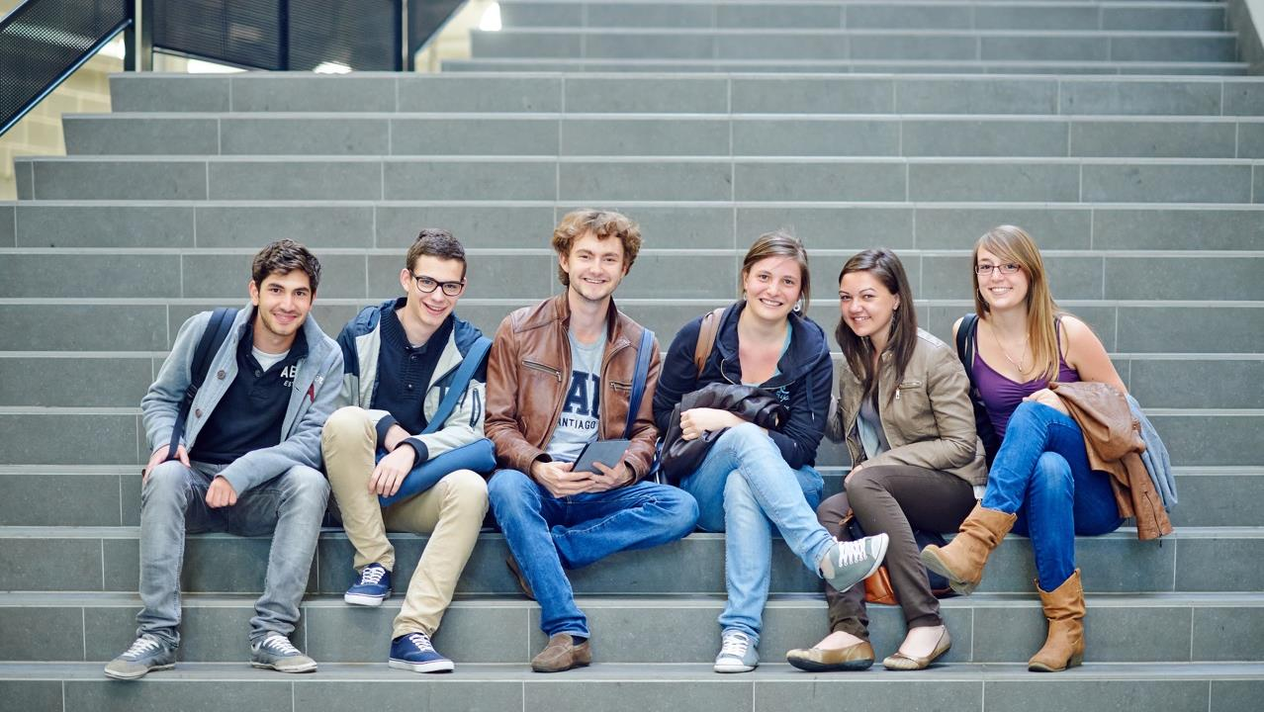
Why other exchange students before you
choose Solvay

Slide 12
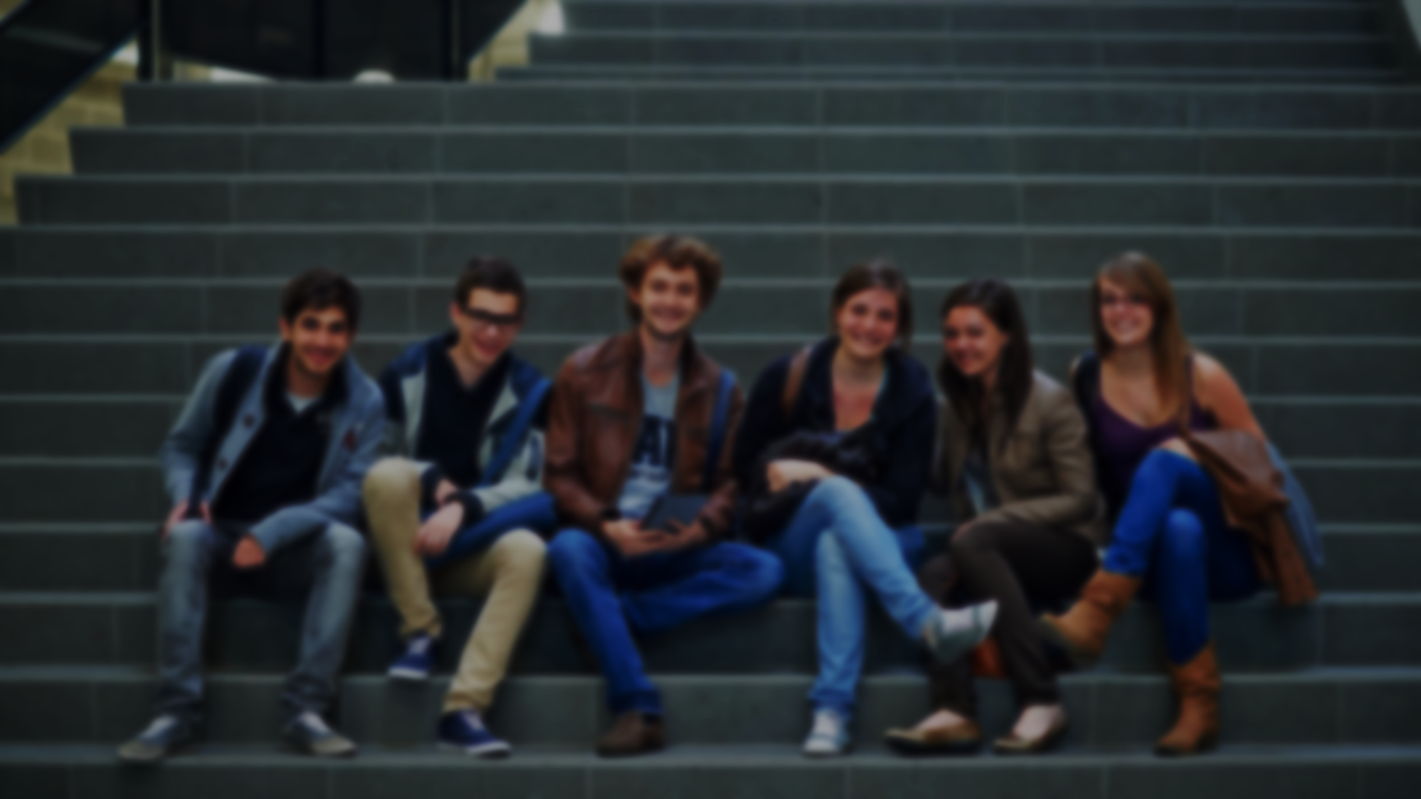
Why other exchange students before you
choose Solvay
47,5%
Quality / reputation of the School
70%
Location
42,5%
Spoken Languages
30%
Recommended by other students
27,5%
Recommended by own university
22,5%
Cultural environment

Slide 13

Beyond the academics…
what they enjoyed the most
Experimenting another culture
Social life
Travel, environment

Slide 14

Learning Abroad
with Exchange Programmes
Notes:
EXCHANGE PROGRAMMES

Slide 15
Learning Abroad
with Exchange Programmes
International
140+
partners around the World
50% outside Europe
65% accredited
Notes:
EXCHANGE PROGRAMMES

Slide 16



Learning Abroad
Double degrees:
Politecnico di Milano
LUISS in Rome
University of Antwerp
QTEM Network
QTEM educates a global elite of future decision makers
By bringing together outstanding
corporate partners & top level
academic institutions
Initiated & founded by Solvay

Slide 17























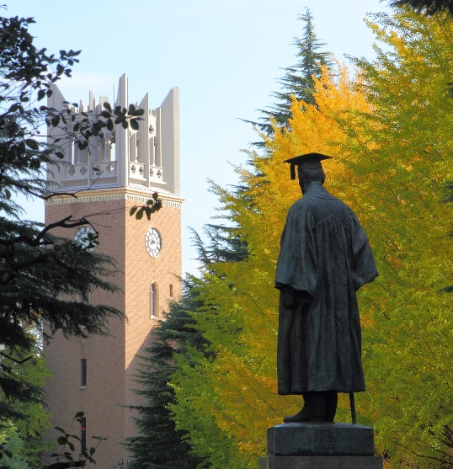
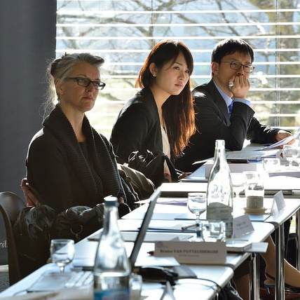
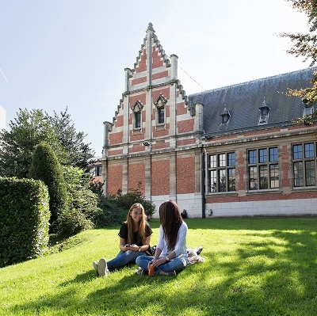
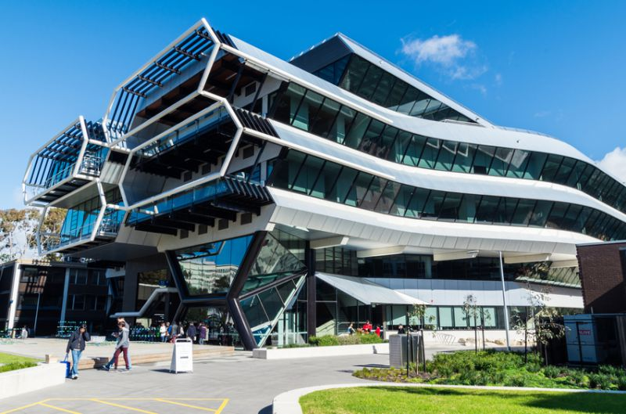

Academic Partners
The universities behind QTEM

Slide 18
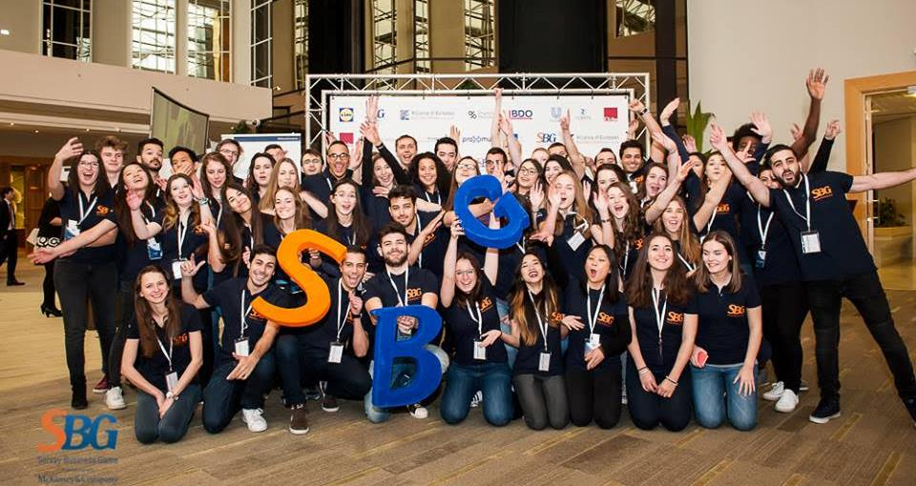
EXPERIENCE REAL LIFE BUSINESS with Solvay Business Game
Notes:
http://www.solvaybusinessgame.com

Slide 19
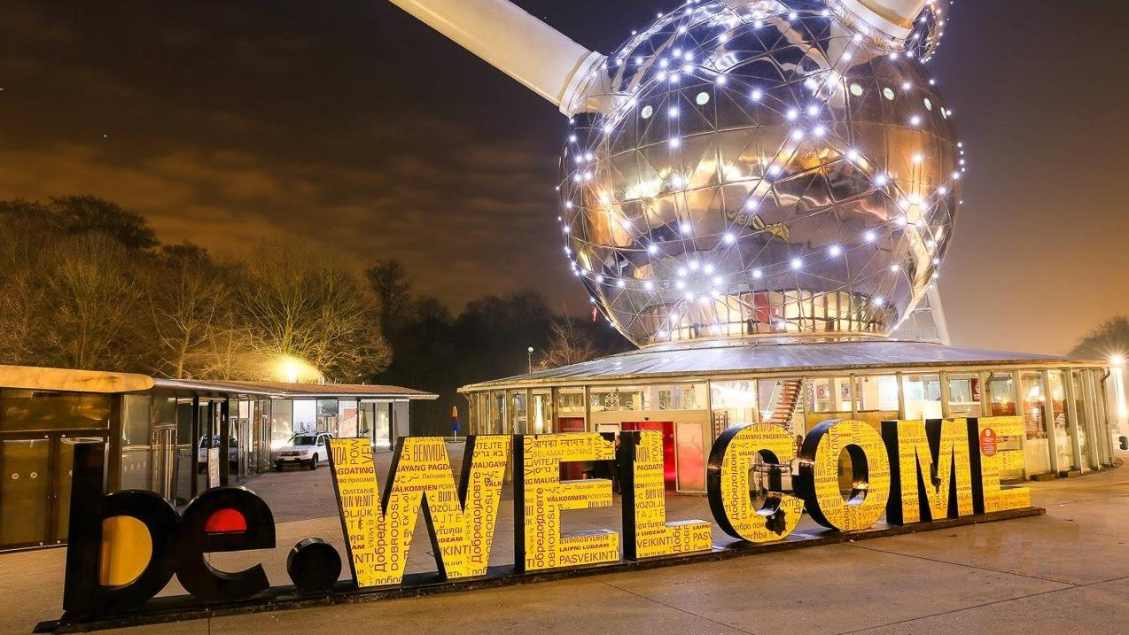

Slide 20
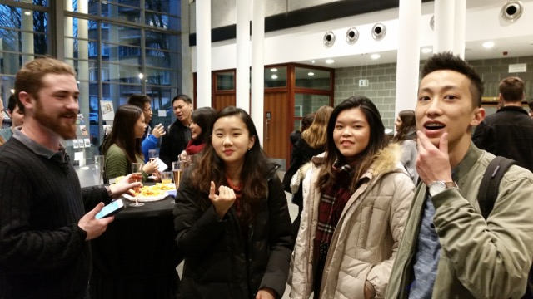
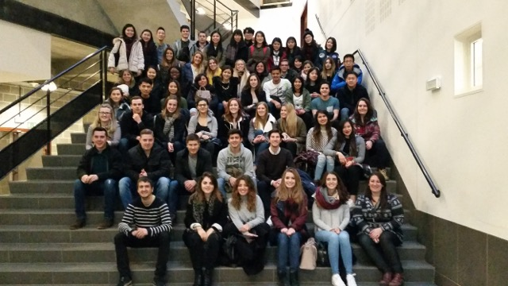
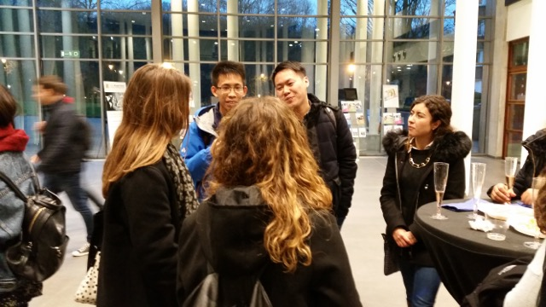
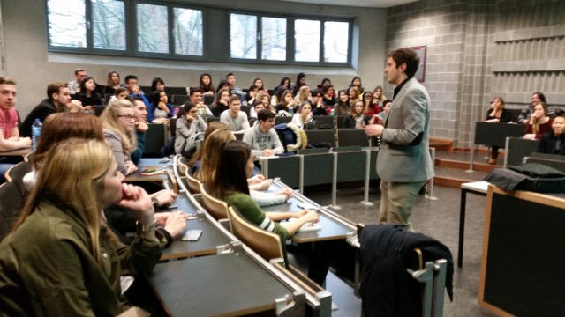
Welcome !
Orientation week

Slide 21
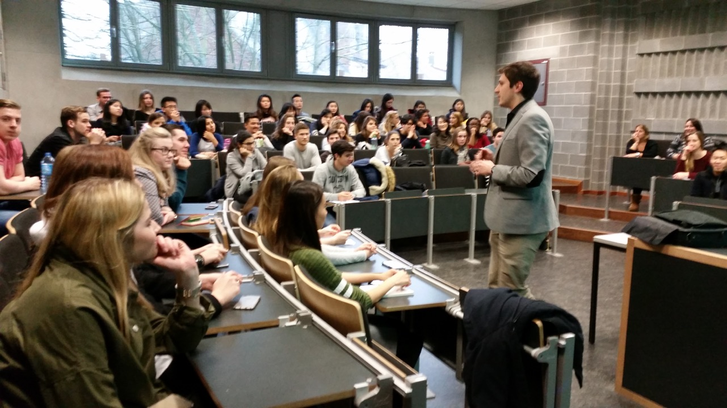
Orientation week
Welcome meetings
Q&A session
Crash French courses
Welcome drink
Social activities (parties, cultural visits, etc)

Slide 22
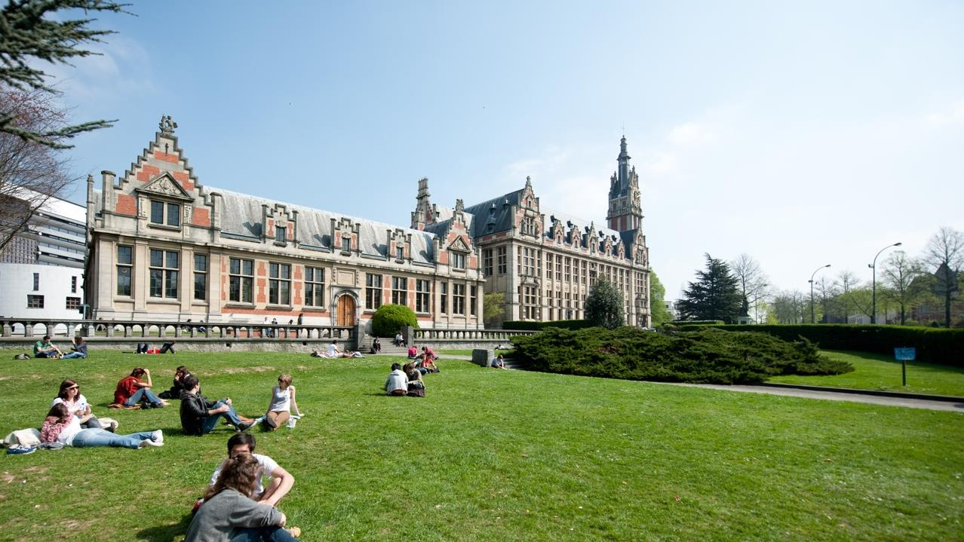
ULB: Université libre de Bruxelles

Slide 23
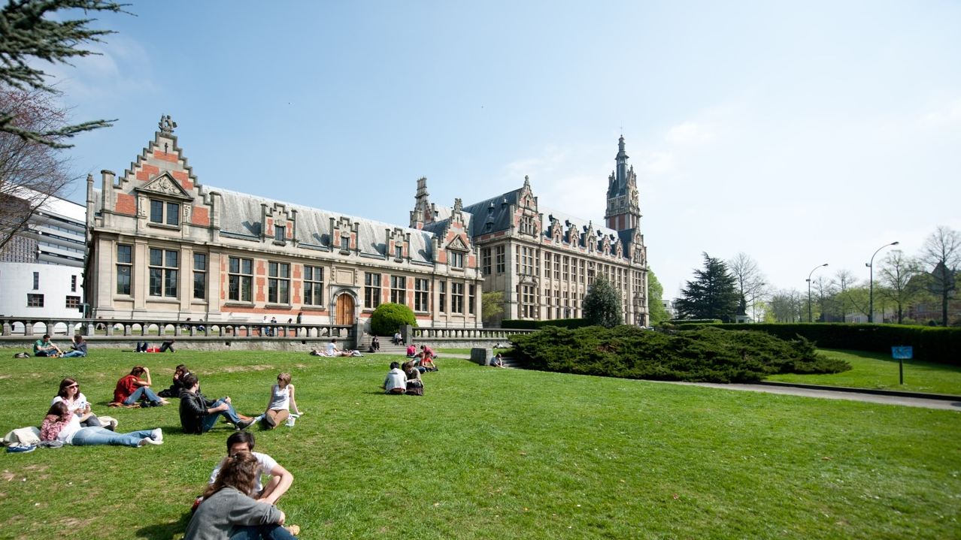
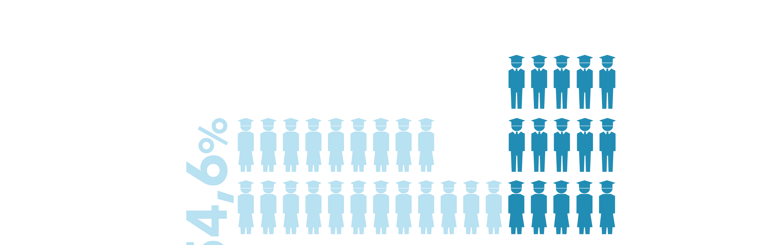
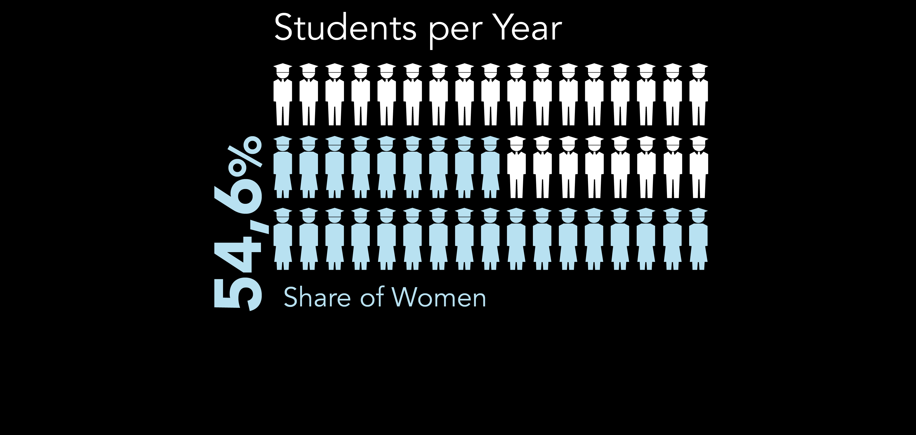


38,000
32%
International students

Slide 24
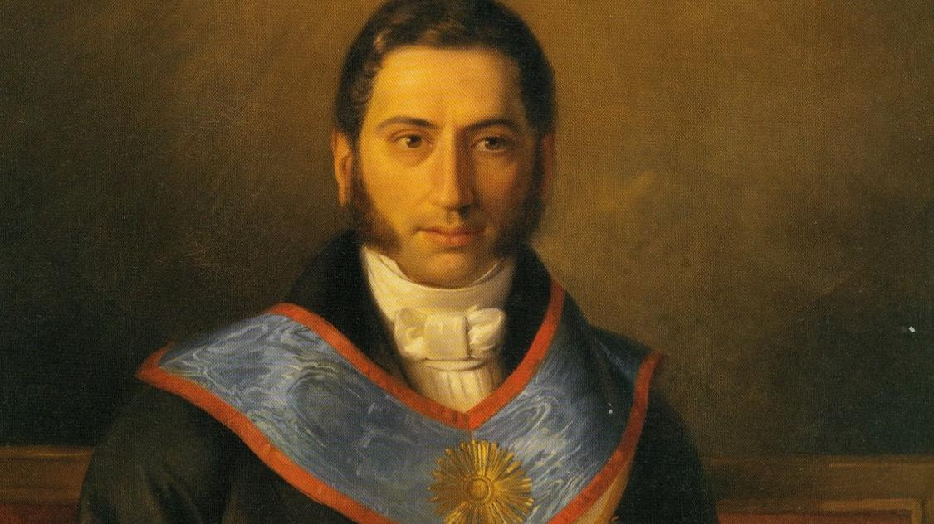
The ULB
OUR STORY
1834
Théodore
Verhaegen

Slide 25


OUR VALUES

Slide 26
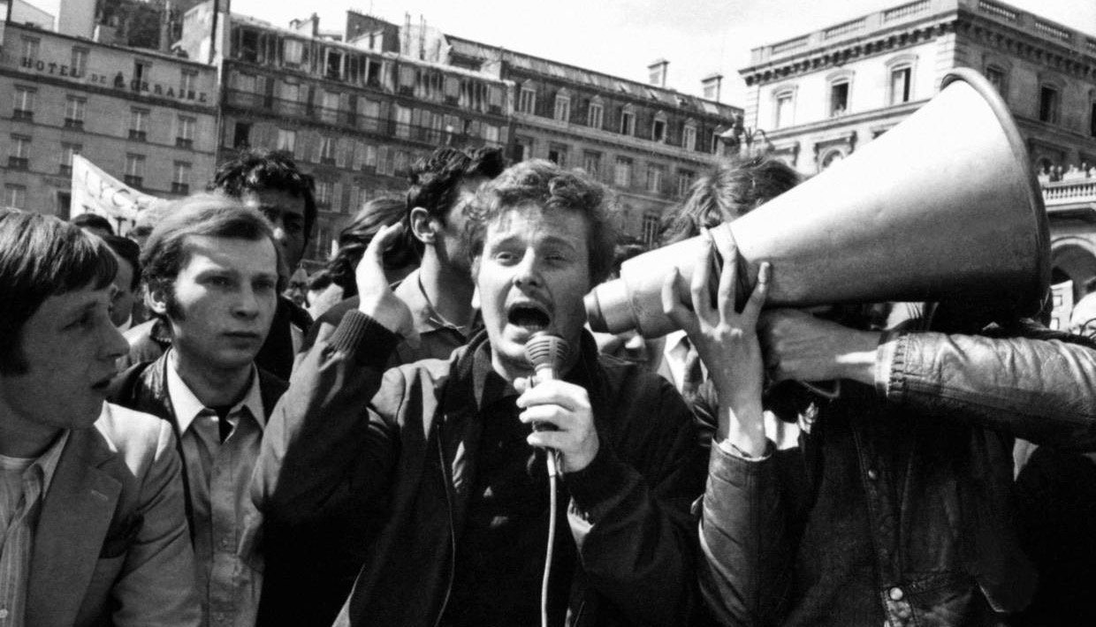
Critical Thinking and free inquiry

Slide 27

Great variety of disciplines

Slide 28
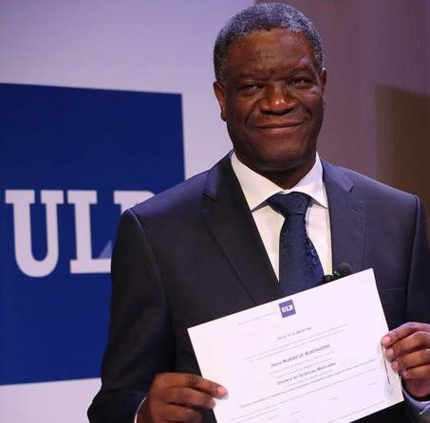
6
NOBEL PRIZES
Denis Mukwege
2019 Nobel Peace Prize

Slide 29
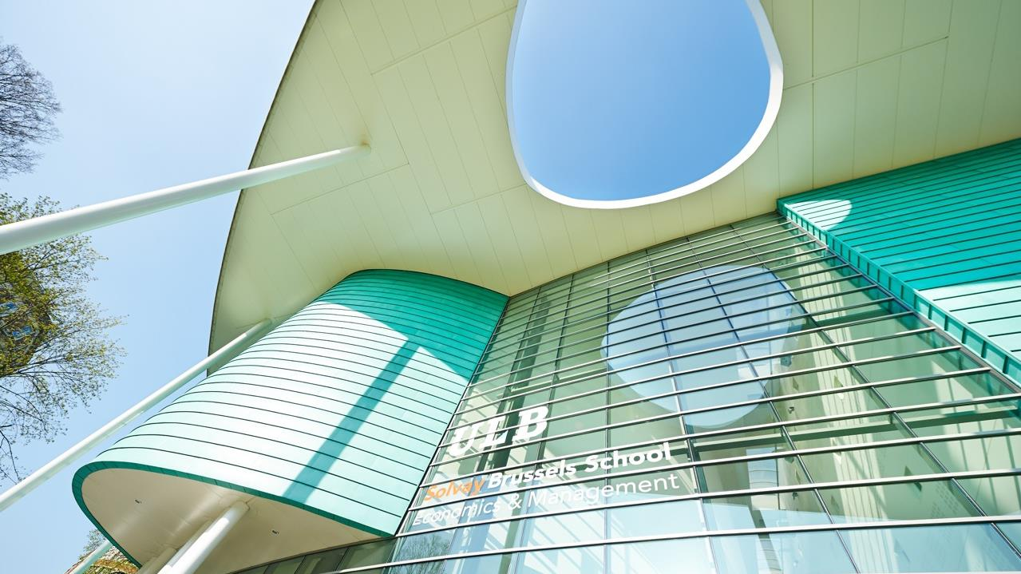
Solvay Brussels School

Slide 30
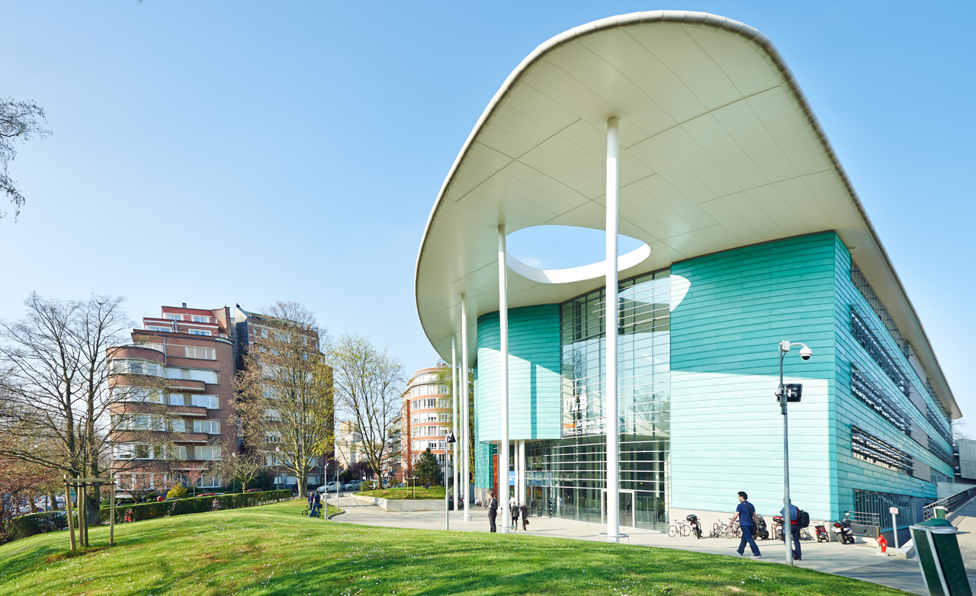
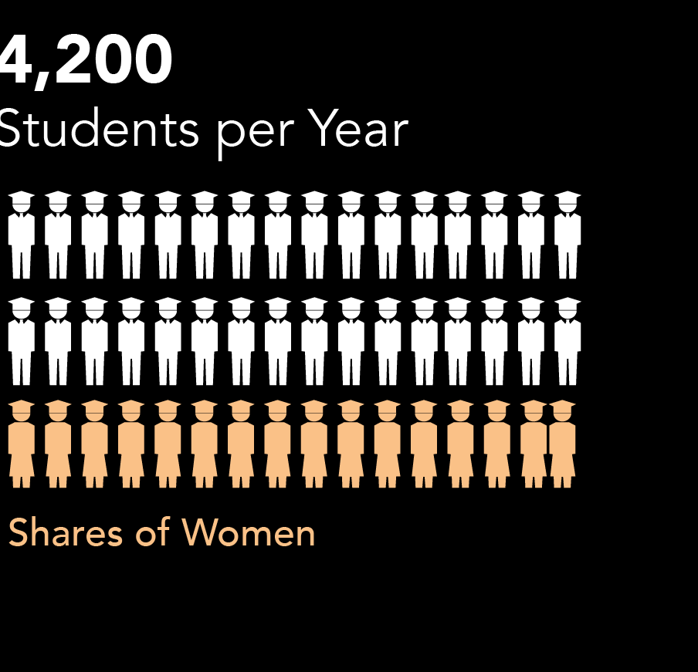

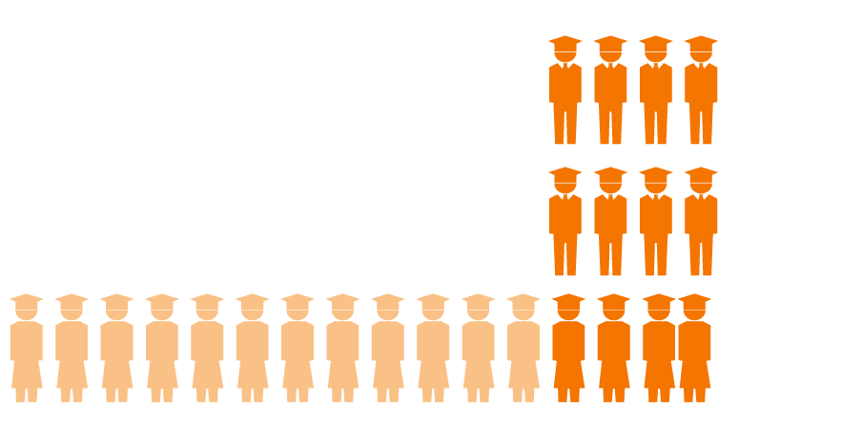

40%
27%
International students

Slide 31
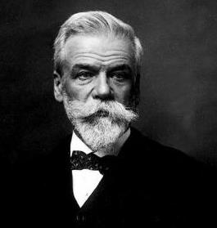
Ernest Solvay
The School’s Story
1903
Science
Innovation
Leadership
Social Responsability

Slide 32
Curiosity driven
Notes:
https://en.wikipedia.org/wiki/Solvay_Conference
Photograph of the first conference in 1911 at the Hotel Metropole. Seated (L-R): W. Nernst, M. Brillouin, E. Solvay, H. Lorentz, E. Warburg, J. Perrin, W. Wien, M. Curie, and H. Poincaré. Standing (L-R): R. Goldschmidt, M. Planck, H. Rubens, A. Sommerfeld, F. Lindemann, M. de Broglie, M. Knudsen, F. Hasenöhrl, G. Hostelet, E. Herzen, J.H. Jeans, E. Rutherford, H. Kamerlingh Onnes, A. Einstein and P. Langevin.

Slide 33

Our Values

Slide 34

Entrepreneurial Spirit

Slide 35

Opportunity for All

Slide 36


OUTSTANDING
RIGOR & DISCIPLINE

Slide 37


MULTI-DISCIPLINARY

Slide 38
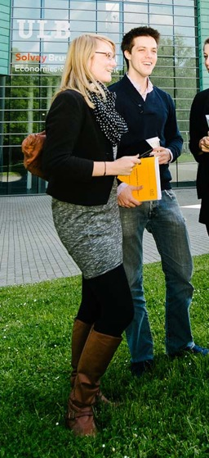
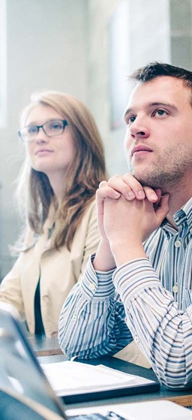
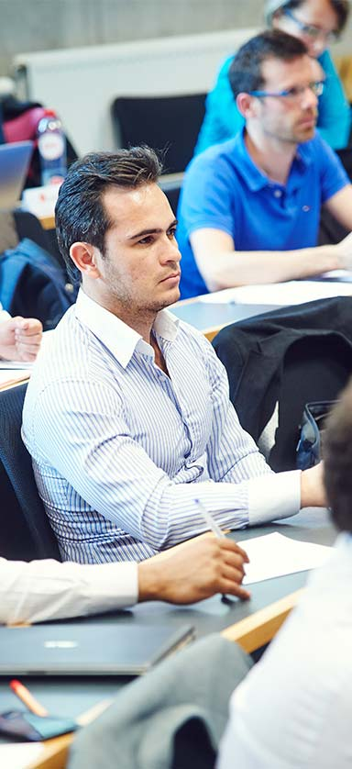

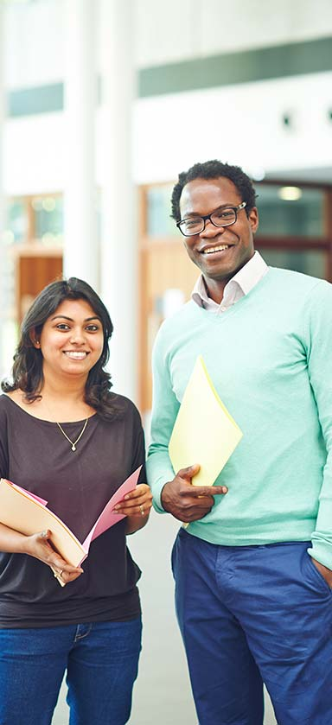
BACHELORS
MASTERS
ADvanced
MASTERS
PhD’s
EMBA & Executive
Education

Slide 39


Permanent focus on Quality

Slide 40
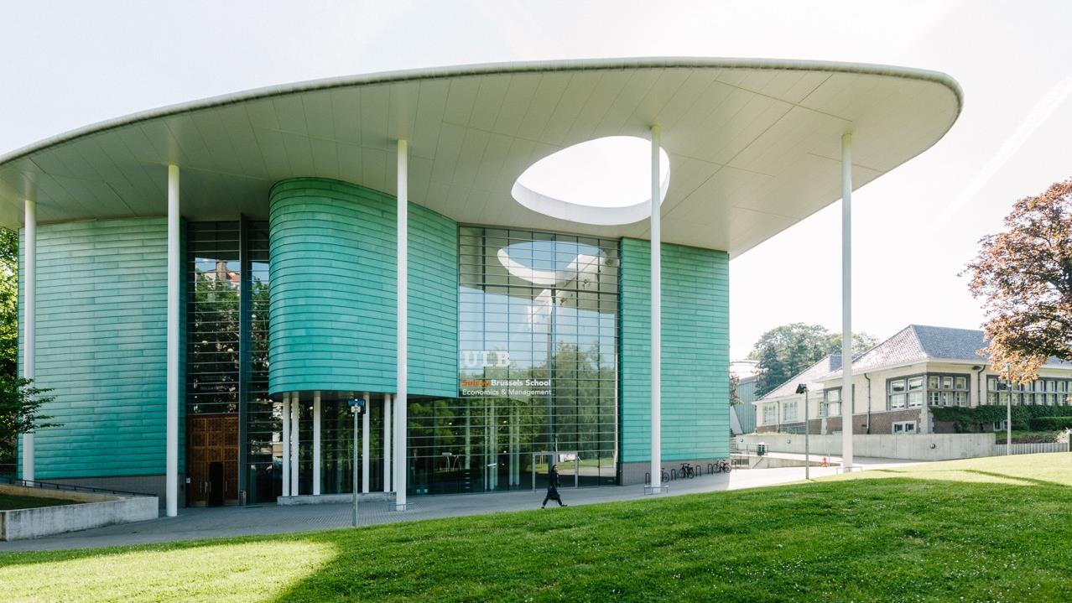

Slide 41
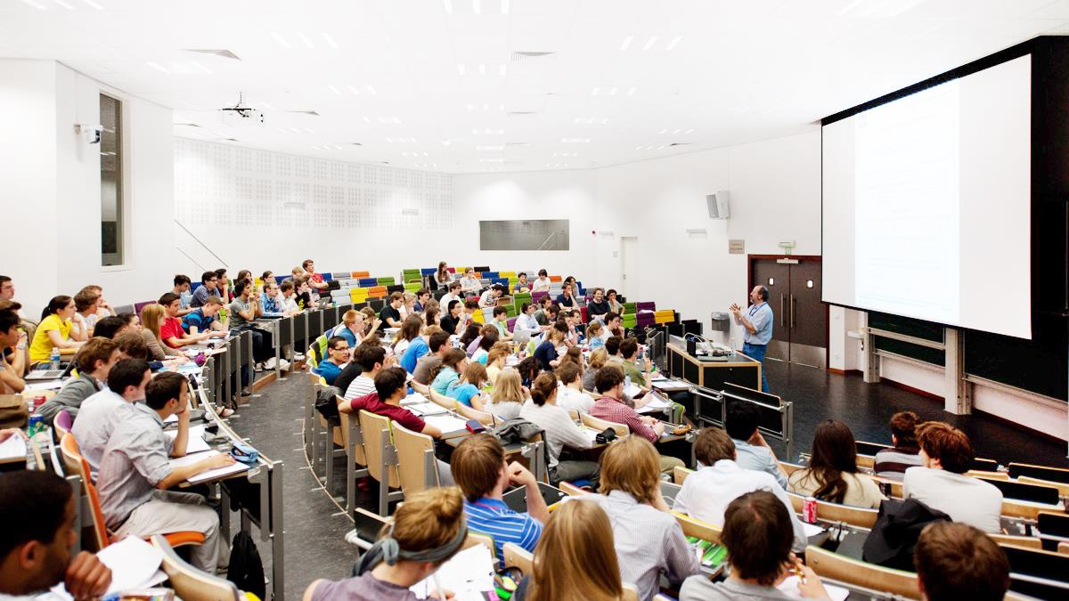

Slide 42
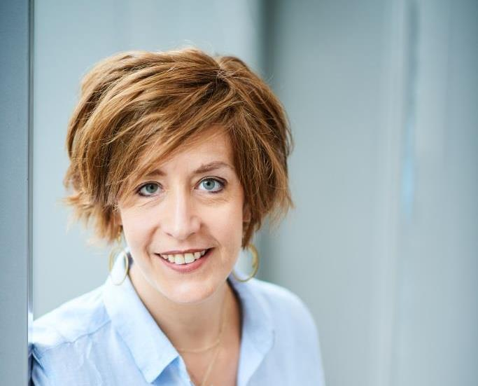
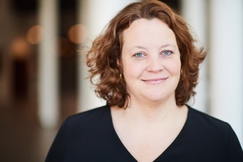


Contact
Tamara SCHULLER
Head of International Relations / Outgoing Students
Building H, Room H.4.153
50, av. F.D. Roosevelt - CP 135
1050 Brussels
tamara.schuller@ulb.be
Tel: +32 (0)2 650.41.68
Anne GEORGES
Coordinator / Incoming Students
Building H, Room H.4.154
50, av. F.D. Roosevelt - CP 135
1050 Brussels
anne.georges@ulb.be
Tel: +32 (0)2 650.45.76
sbsem.ulb.be/international SolvayInternational

